Slide 1
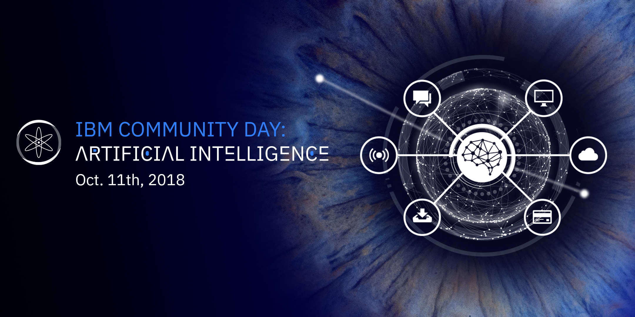
A real-time ML application on IBM Cloud Private for Data
SRIRAM SRINIVASAN
Architect, Senior Technical Staff Member
IBM Cloud Private for Data

Slide 2
IBM Cloud Private for Data
A quick introduction

Slide 3
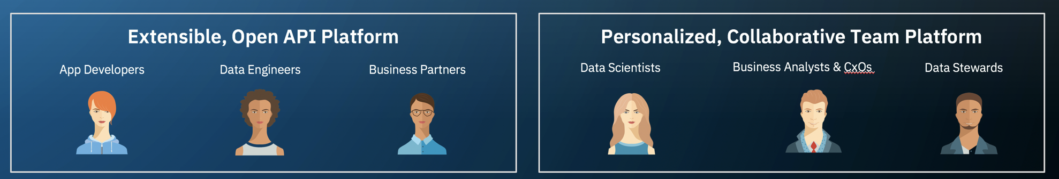
IBM Cloud Private for Data An Integrated Platform for Accelerating Analytics
Gather & Manage Data
Understand & Govern Data
Prepare Data for Analysis
Connect, discover & provision data sources
Auto Classify, Catalog and Govern data for both compliance and insights
Integrate, cleanse and shape your data. Share dashboards for visualizing data
Build Analytics Apps & Models
- and automate
Model Management & Deployments
Create AI -powered Applications
DevOps for analytical models & interactive notebooks and apps
Deploy and scale – for high performance real-time use cases
CICD for analytics assets
Incorporate trusted and governed models into applications, dashboards, and operational systems – achieve AI
Create Predictive ML, Deep Learning with GPUs, Prescriptive Optimizations, and other advanced mathematical models. Interactive notebooks & Apps

Slide 4















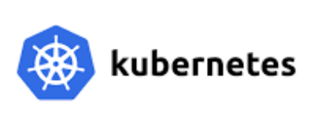

An Open, Scalable & Extensible Platform for Accelerating Data Science/AI
*
IDEs & Visual tooling
Projects: collaboration & versioning
Data Refinery
SPSS Modeler*
Decision* Optimization
Watson * Explorer
content analytics
ML
Machine Learning Environments
model management, deployments & scoring server scale-out
Machine Learning Environments
Deep Learning Environments
(with GPU affinity)
Custom
runtimes
Languages & Runtimes
+ add custom images & package management
Cloud-Native Platform & Eco-System
Scale-out & load-balancing
* In Roadmap

Slide 5

Developing a sample real-time Cloud Native Solution
on ICP for Data
check back later on GitHub for samples & tips
https://github.com/sriramsrinivasangmail/ibmai-community-day-oct-2018

Slide 6
Problem overview
Note: completely fictional scenario
Breast Cancer diagnostic
A medical lab has a series of tests being performed on a daily basis
The expectation is for these tests to be analyzed and initial results returned back to the clinic while the patient is still present in the lab
Requirements
The clinics could be spread out in different locations – and reliability is important in spite of network issues
Processing a stream of tests with extremely short latency (real-time , near-real-time)
Scale out is important - with an increase in the number of concurrent test requests, compute would need to be seamlessly expanded.
Truly hybrid with portability & Standardization - the enterprise may start behind their own firewalls, but may need to burst out into the public cloud as they grow

Slide 7









How does ICP for Data help ?
ICP Foundation - the Kubernetes based environment for delivering Cloud native solutions
Kubernetes-based Container Platform
Industry leading container orchestration platform across private, hybrid & public clouds
Intelligent Scheduling
Automatically places containers based on their resource requirements and other constraints, while not sacrificing availability. Mix critical and best-effort workloads in order to drive up utilization and save even more resources.
Horizontal Scaling
Self Healing
Scale your application up and down with a simple command, with a UI, or automatically based on CPU usage.
Restarts containers that fail, replaces and reschedules containers when nodes die, kills containers that don't respond to your user-defined health check, and doesn't advertise them to clients until they are ready to serve.
Data & Analytics Collaborative platform for accelerating AI
Data Scientist
& ML Practitioners
Admin/Ops
Explore, Profile & Understand Data
ML Feature engineering
Visualizations
Notebooks
- Train Models - Dashboards, apps
Models,
Scoring services
& Apps
Deploy & monitor accuracy
Analyzes
Experiments, trains models
Evaluates model accuracy
Publish Apps & models
App. Developer
Real-time Apps
& business processes

Slide 8
The Solution Outline
Clinic ‘1’
Invoke
Prediction
Processor
Predictor ML - Model
Clinic ‘2’
Scoring
Service
Rabbit MQ
+ other
analytics pipeline,
persistence
:
Clinic ‘n’
Note: A simplistic solution . When we start looking at a larger use cases,
for example, with image classification requirements etc., we would need to think
about shipping images & persistence etc.

Slide 9
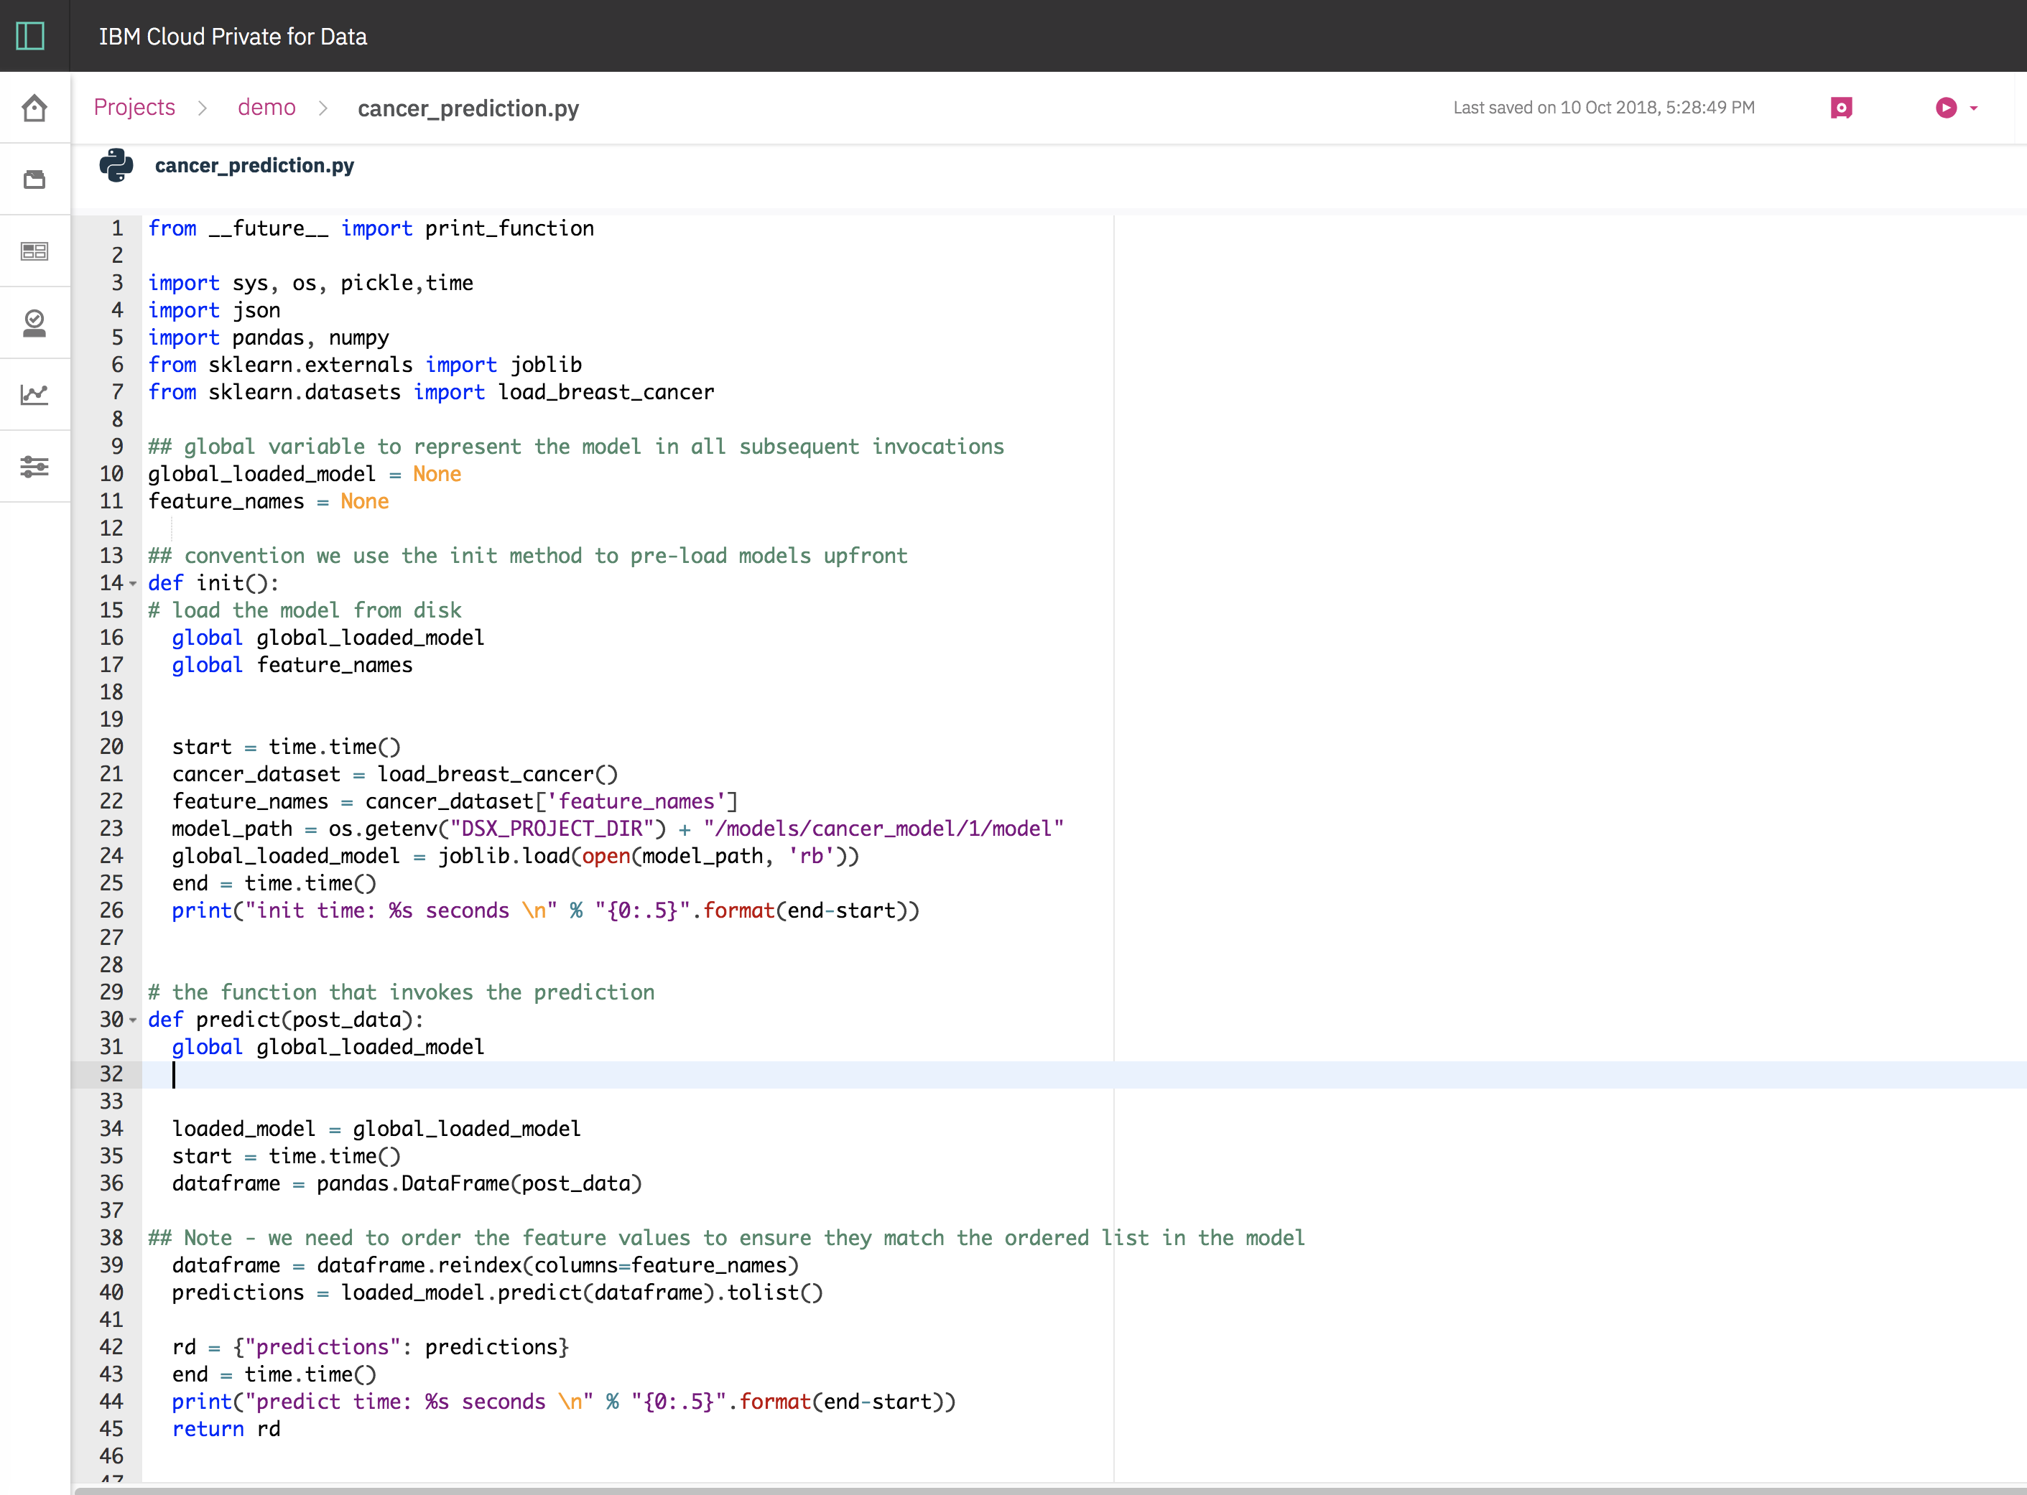
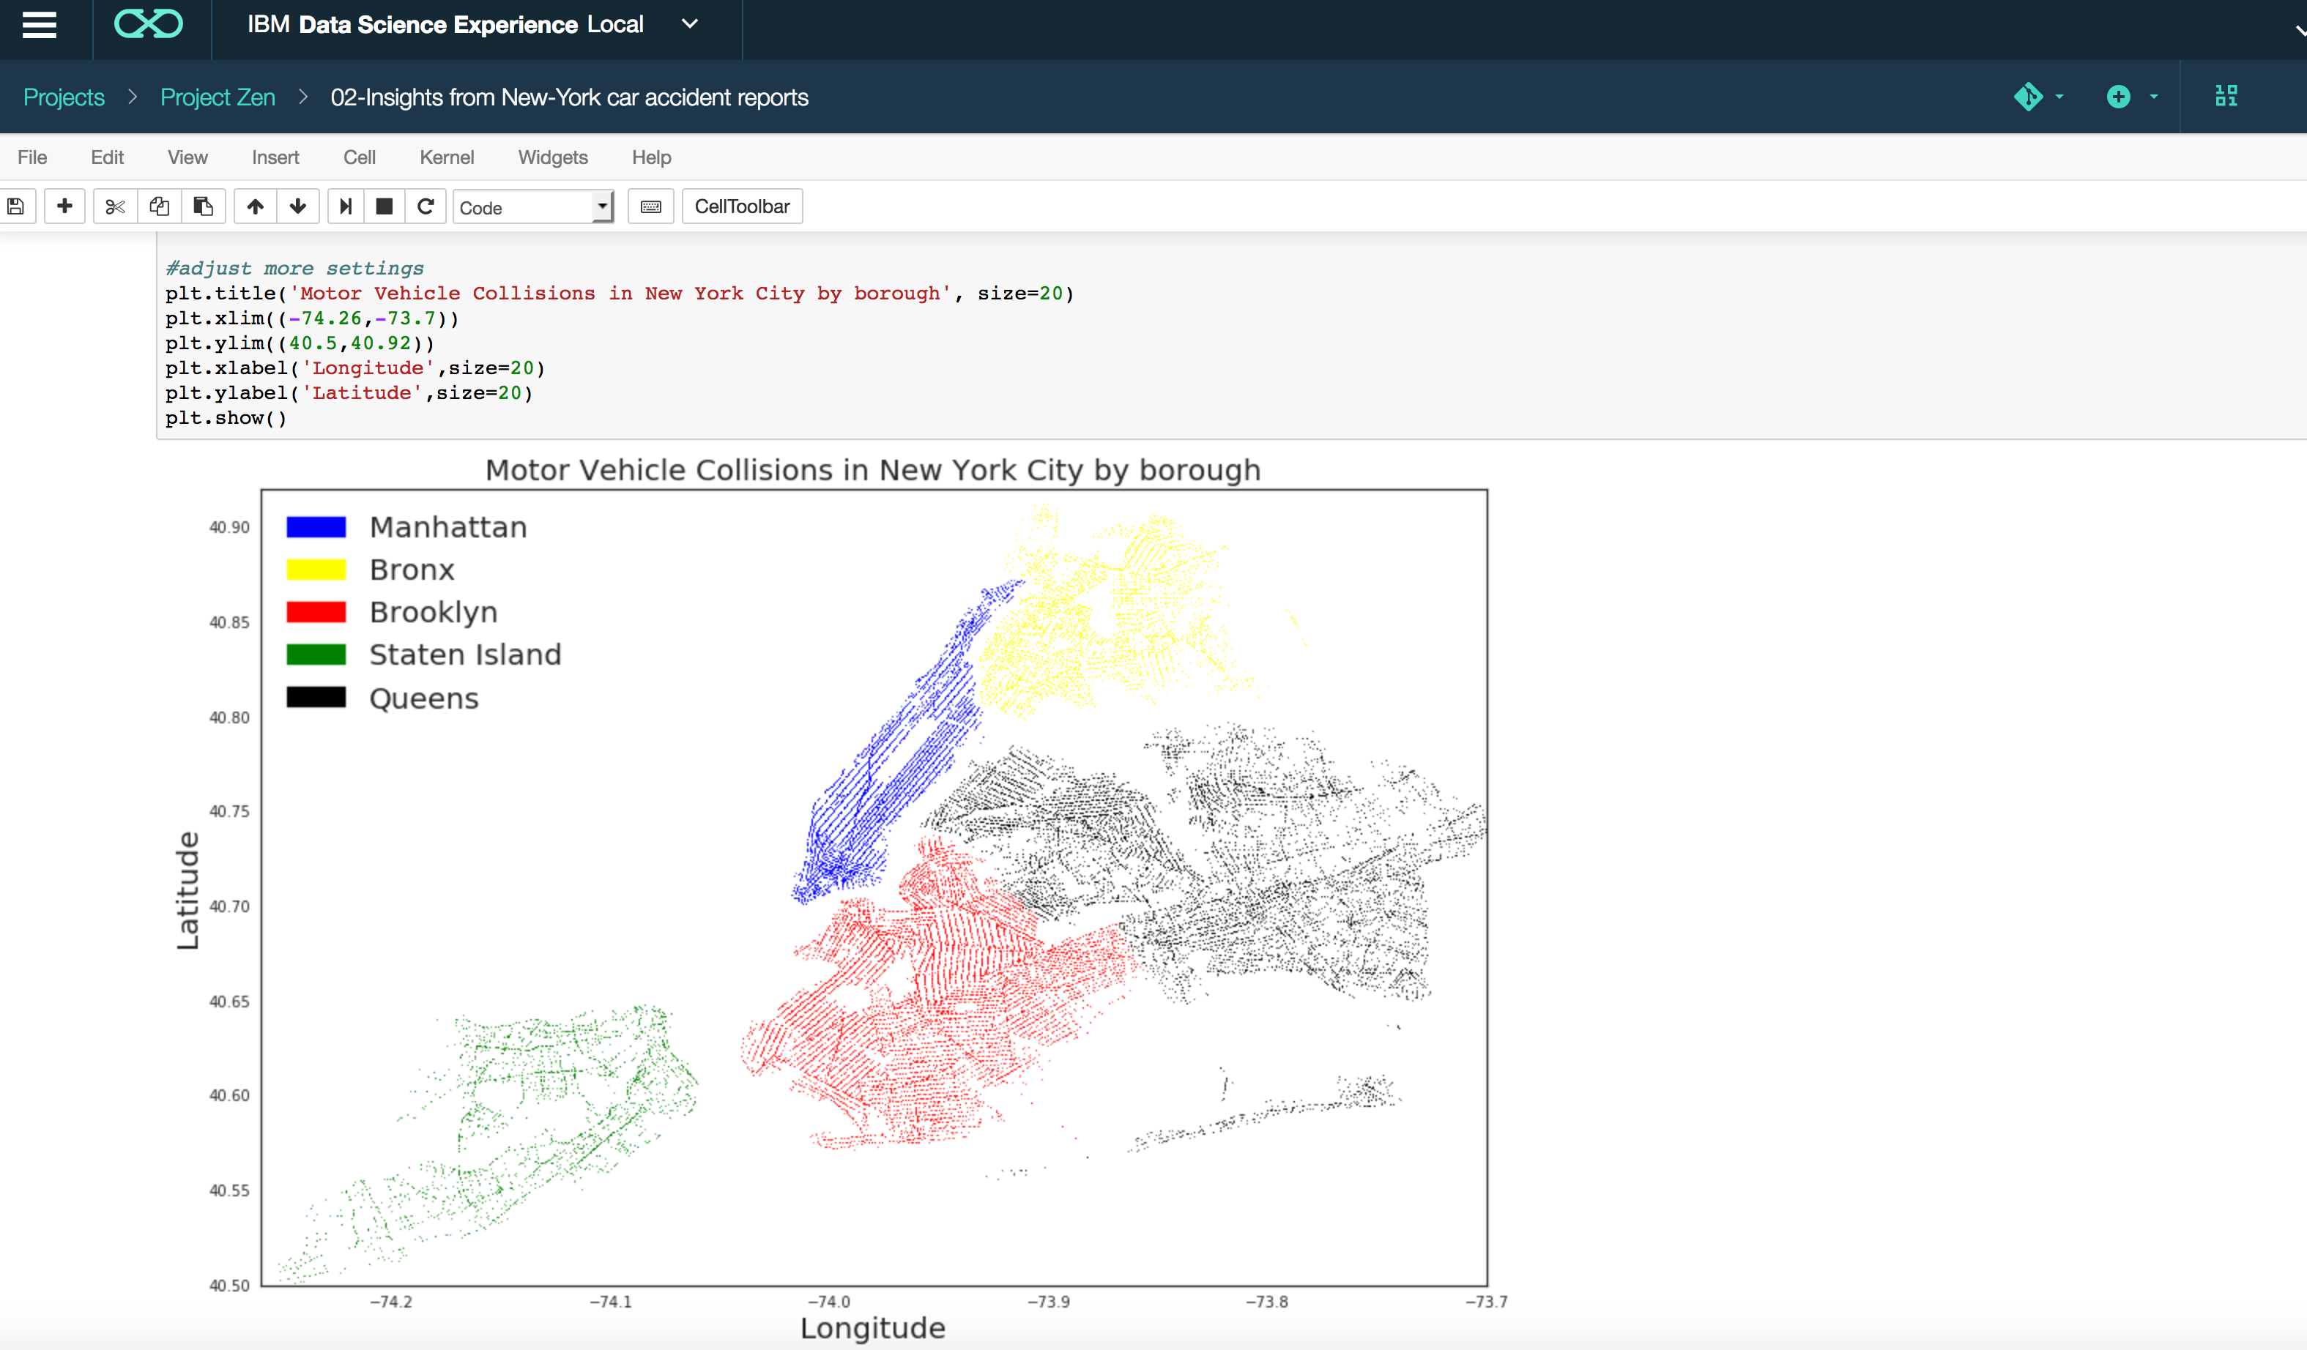
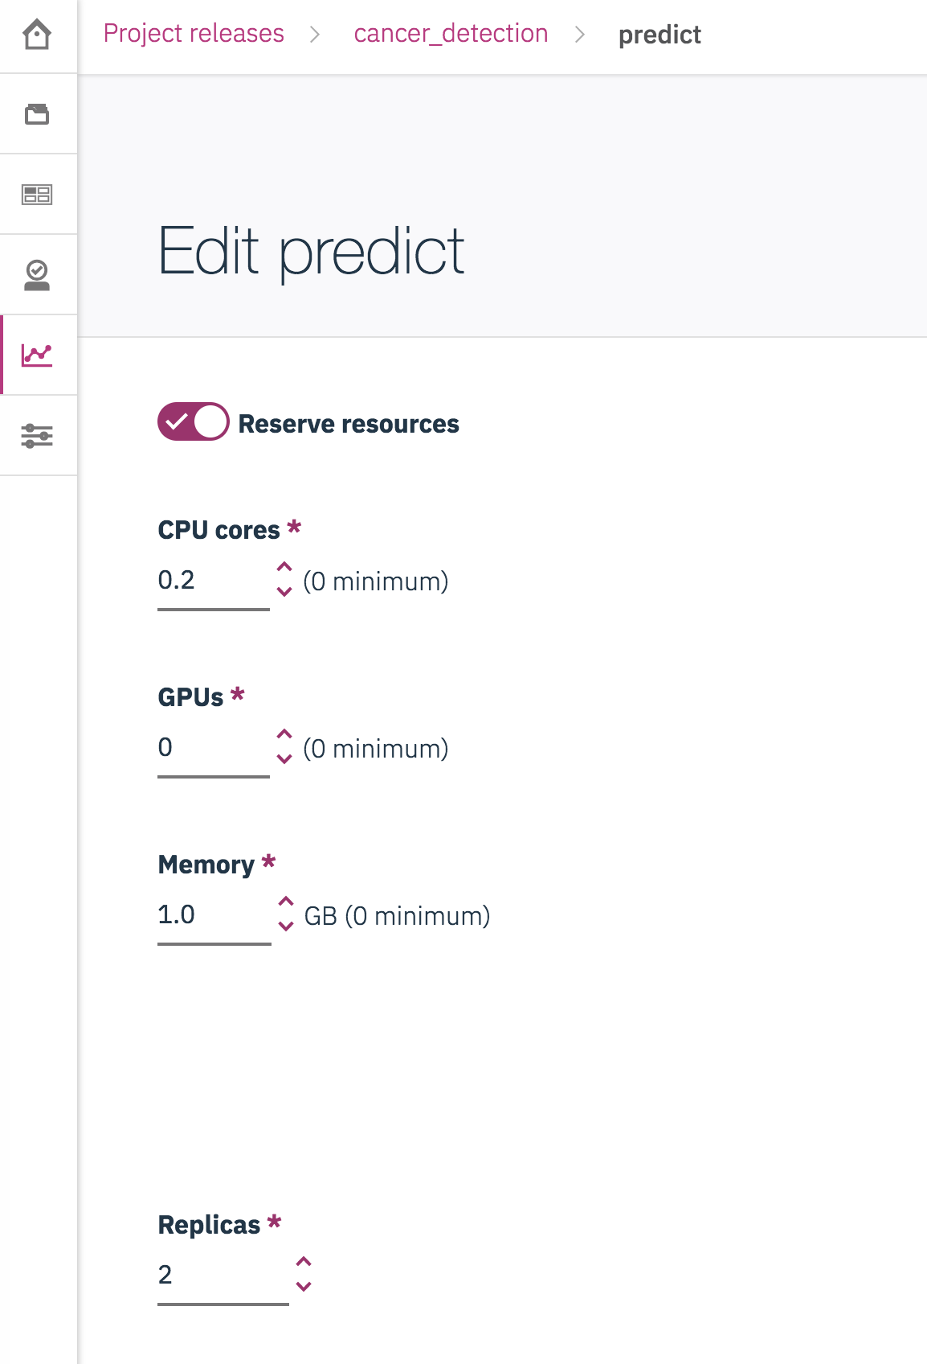
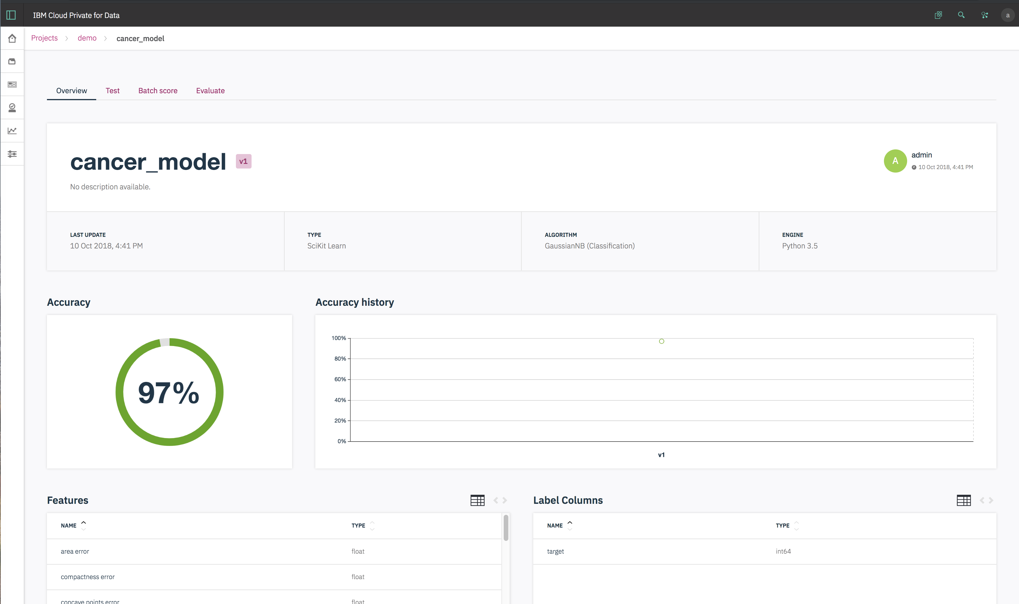
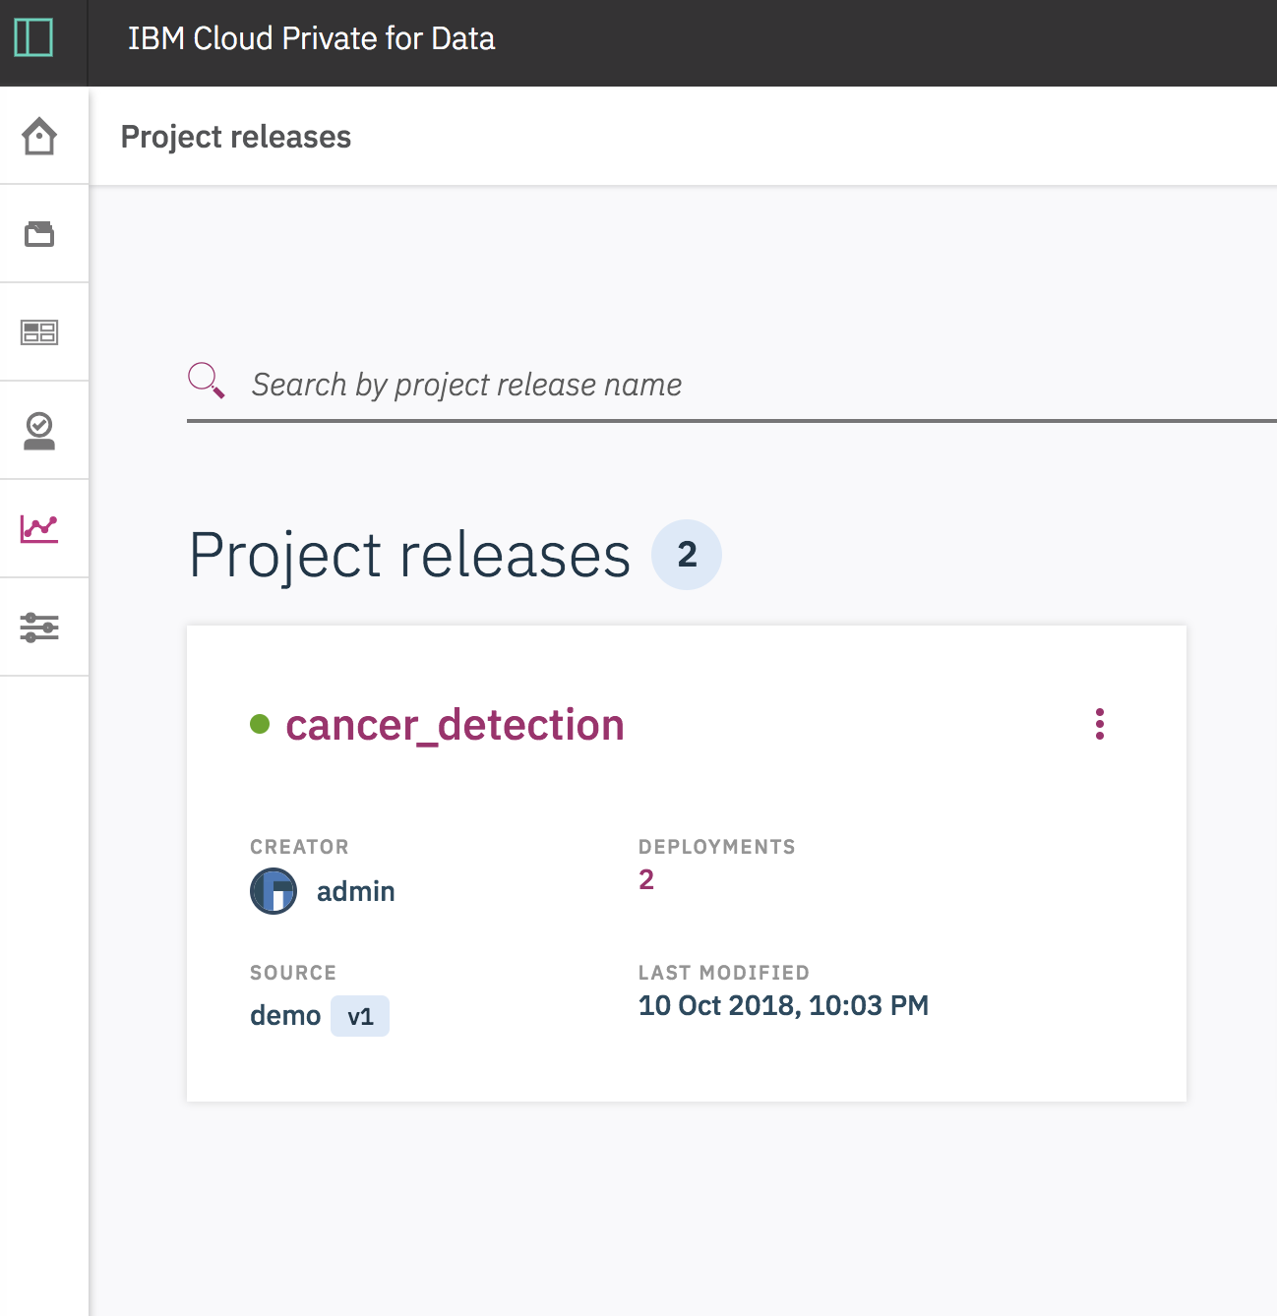
Collaboration is key..
Build & Test out custom scoring services
App. Developer
Jupyter notebook Environment
Iteratively train models
Scale up & out scorers
Data Scientist
& ML Practitioners
Deploy models & expose scoring services
Admin/Ops
Understand your model’s accuracy

Slide 10

Deploying Rabbit MQ
Available in Open Source for Kubernetes
https://github.com/helm/charts/tree/master/stable/rabbitmq
Easily deploy using helm, the package manager for Kubernetes
example:
helm install --tls --name rabbitmq --set rabbitmq.username=admin,rabbitmq.password=password,rabbitmq.erlangCookie=rabbitmq_cookie stable/rabbitmq
and check status:
helm status rabbitmq --tls

Slide 11
Training the model with python/sklearn
Using the Breast cancer wisconsin (diagnostic) dataset
http://scikit-learn.org/stable/datasets/index.html#breast-cancer-wisconsin-diagnostic-dataset
cancer_dataset = load_breast_cancer()
Example with Guassian Naive Bayes:
gnb = GaussianNB()
model = gnb.fit(train, train_labels)
Persist the model using the “dsx_ml” module
from dsx_ml.ml import save
model_name = "cancer_model"
saved_model_output = save(model = model, name = model_name, algorithm_type = 'Classification', x_test=x_test_df.sort(), y_test=test_labels_df)

Slide 12
Example of a custom scorer script
ICP4Data has default scorers out of the Box.
However, for illustration purposes, this example shows how you can build & expose your own scorers as a web service
You can use this example to decide how best to serve the model & respond to predictions
def init():
# load the model from disk
global global_loaded_model
global feature_names
cancer_dataset = load_breast_cancer()
feature_names = cancer_dataset['feature_names']
model_path = os.getenv("DSX_PROJECT_DIR") + "/models/cancer_model/1/model"
global_loaded_model = joblib.load(open(model_path, 'rb'))
# the function that invokes the prediction
def predict(post_data):
global global_loaded_model
loaded_model = global_loaded_model
dataframe = pandas.DataFrame(post_data)
## Note - we need to order the feature values to ensure they match the ordered list in the model
dataframe = dataframe.reindex(columns=feature_names)
predictions = loaded_model.predict(dataframe).tolist()
rd = {"predictions": predictions}
return rd
The init method is loaded only once (on startup)
good place to preload the model
Nothing fancy needed to expose the service.. – just a function that is sent a Dictionary as argument

Slide 13
Example invocation
curl -k -X POST https://mycluster.icp:31843/dsvc/v1/cancer/pyscript/predict/predict
-H “Authorization: Bearer ${accessToken}”
-H 'Cache-Control: no-cache' -H 'Content-Type: application/json’
-d '{"args":{"mean radius":{"0":12.47},"mean texture":{"0":18.6},"mean perimeter":{"0":81.09},"mean area":{"0":481.9},"mean smoothness":{"0":0.09965},"mean compactness":{"0":0.1058},"mean concavity":{"0":0.08005},"mean concave points":{"0":0.03821},"mean symmetry":{"0":0.1925},"mean fractal dimension":{"0":0.06373},"radius error":{"0":0.3961},"texture error":{"0":1.044},"perimeter error":{"0":2.497},"area error":{"0":30.29},"smoothness error":{"0":0.006953},"compactness error":{"0":0.01911},"concavity error":{"0":0.02701},"concave points error":{"0":0.01037},"symmetry error":{"0":0.01782},"fractal dimension error":{"0":0.003586},"worst radius":{"0":14.97},"worst texture":{"0":24.64},"worst perimeter":{"0":96.05},"worst area":{"0":677.9},"worst smoothness":{"0":0.1426},"worst compactness":{"0":0.2378},"worst concavity":{"0":0.2671},"worst concave points":{"0":0.1015},"worst symmetry":{"0":0.3014},"worst fractal dimension":{"0":0.0875}}}'
Example response
{ "stdout": [ "predict time: 0.014577 seconds ", "" ], "stderr": [], "result": { "predictions": [ 1 ] } }

Slide 14
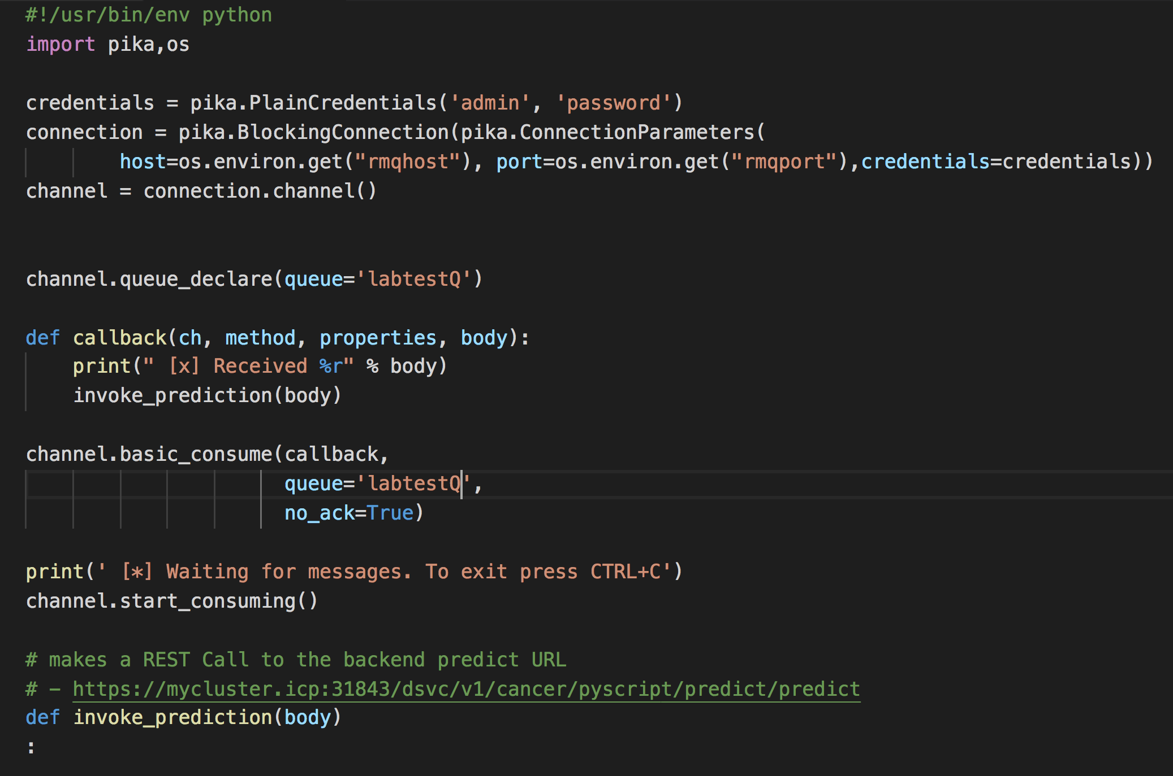
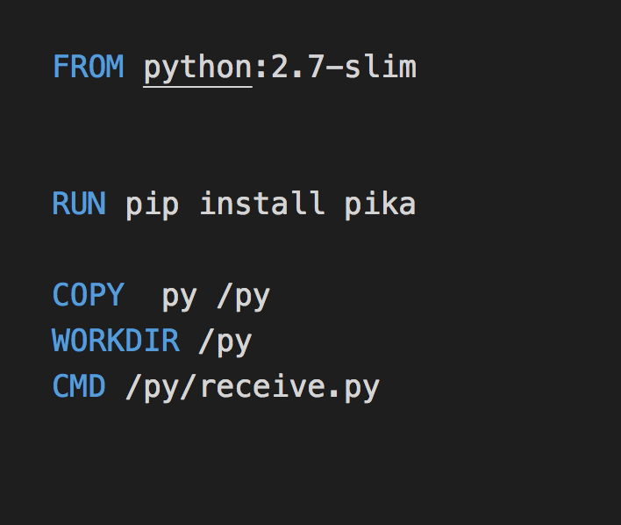
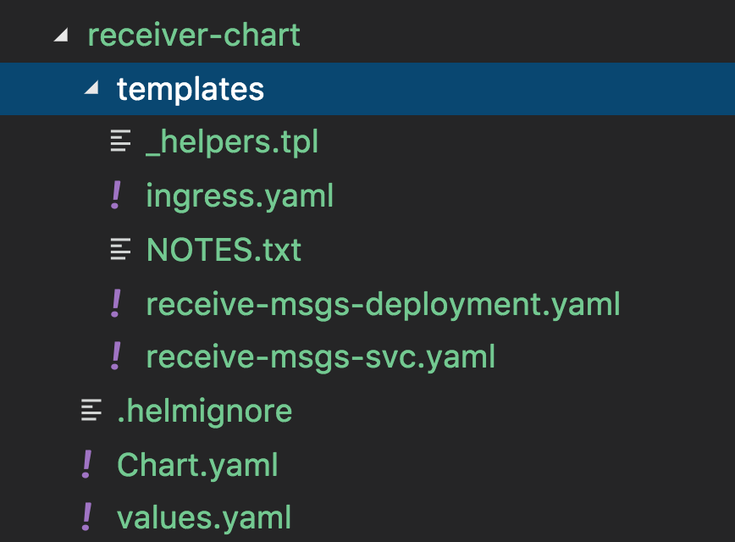
Sample python applications to work with Rabbitmq
Using Pika module to work with Rabbitmq
Simple Dockerfile – to containerize the “receive” app.
The first step to creating it as a microservice
messages are received via labtestQ and can be used to invoke the prediction..
docker build -f Dockerfile -t mycluster.icp:8500/default/receive-msgs:v1 .
Simple Helm chart to deploy this Python application into ICP/Kubernetes
Example Deployment the receiver app to ICP:
# push the image
docker push mycluster.icp:8500/default/receive-msgs:v1
#deploy the chart
helm install --tls --name=receiver ./receiver-chart/

Slide 15
References: Learn more about Cloud Native, Docker, Kubernetes
ICP4Data:
http://ibm.biz/data4ai
Cloud Native Computing Foundation https://www.cncf.io/
The Twelve Factor app – a methodology (best practices) for building “software-as-a-service-apps”: https://12factor.net/
Getting Started with Docker
https://docs.docker.com/get-started/
https://kubernetes.io/docs/tutorials/kubernetes-basics/
https://azure.microsoft.com/en-us/resources/videos/the-illustrated-children-s-guide-to-kubernetes/
https://kubernetes.io/docs/user-guide/docker-cli-to-kubectl/
https://www.udacity.com/course/scalable-microservices-with-kubernetes--ud615
https://github.com/kubernetes/kubernetes/tree/master/examples - lots of examples of how software gets deployed in Kube
IBM Cloud Private : https://www.ibm.com/cloud/private/developer
Take the IBM Cloud Private for Data Experience for a test drive: https://www.ibm.com/cloud/garage/cloud-private-experiences/icpd

Slide 16
Summary
You saw a set of examples on how ICP & ICP For Data can help you ramp up quickly in building real-time applications
Instantiate key services such as rabbitmq
Train ML models
Expose scoring servers
Deploy cloud native applications
check back later on GitHub for samples & tips
https://github.com/sriramsrinivasangmail/ibmai-community-day-oct-2018

Slide 17
Thank you !
check back later on GitHub for samples & tips
https://github.com/sriramsrinivasangmail/ibmai-community-day-oct-2018

Slide 18

IBM Cloud Private for Data A key Scenario : Accelerate Data Applications with Governed Analytics
Data Engineer
Development
& prototyping
Exec
Sets goals &
measures results
Collects
Builds data lakes
and warehouses
Gets Data Ready for Analytics
Problem Statement or target opportunity
Search for Data
App. Developer
Production
Infuses ML in apps & processes
Trusted
analytics
Explores & Understands Data, distributions
Real-time Apps
& business processes
Analyst/
Data Scientist
Refine
PRODUCTION
Secure & Governed
Monitor & Instrument
High Throughput
-Load Balance & Scale
Reliable Deployments
- outage free upgrades
Preps, Transforms & Persists Data
Data Steward
Deploy, monitor model accuracy, latencies
Auto-retrain & upgrade
Analyzes
Explores, Shapes data
& trains models
- Train Models - Dashboards, apps
ML Feature engineering
Visualizations
Notebooks
Organizes
Data & Analytics Asset Enterprise Catalog
Lineage
Governance of Data & Models
Audits & Policies
Enables Model Explainability
Admin/Ops
Features, Lineage/Relationships recorded
in Governance Catalog
Experiments

Slide 19
Brought to you by community.ibm.com/icpfordata Catch the replay at ibmaicommunity.bemyapp.com

